Slide 1

Docker
Jon Grythe Stødle

Slide 2
Your code
Ubuntu / Base
Docker
Host

Slide 3
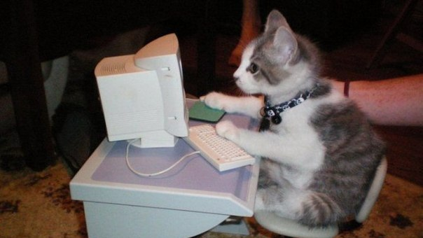
DEMO

